Slide 1



Generating Colorized 3D Object Model with 2D Image Views
Tuan-Anh VU* Yingshu CHEN* Wishsmitha Samadhi MENDIS* Sai-Kit Yeung

Slide 2
Outline
Introduction
Methodology
Experimental results
Conclusion and future work

Slide 3
Introduction
Difficult to generate a 3D model
with different types of lighting and shading
with background and foreground
with different styles: winter, summer, spring, fall ...

Slide 4
Methodology

Slide 5
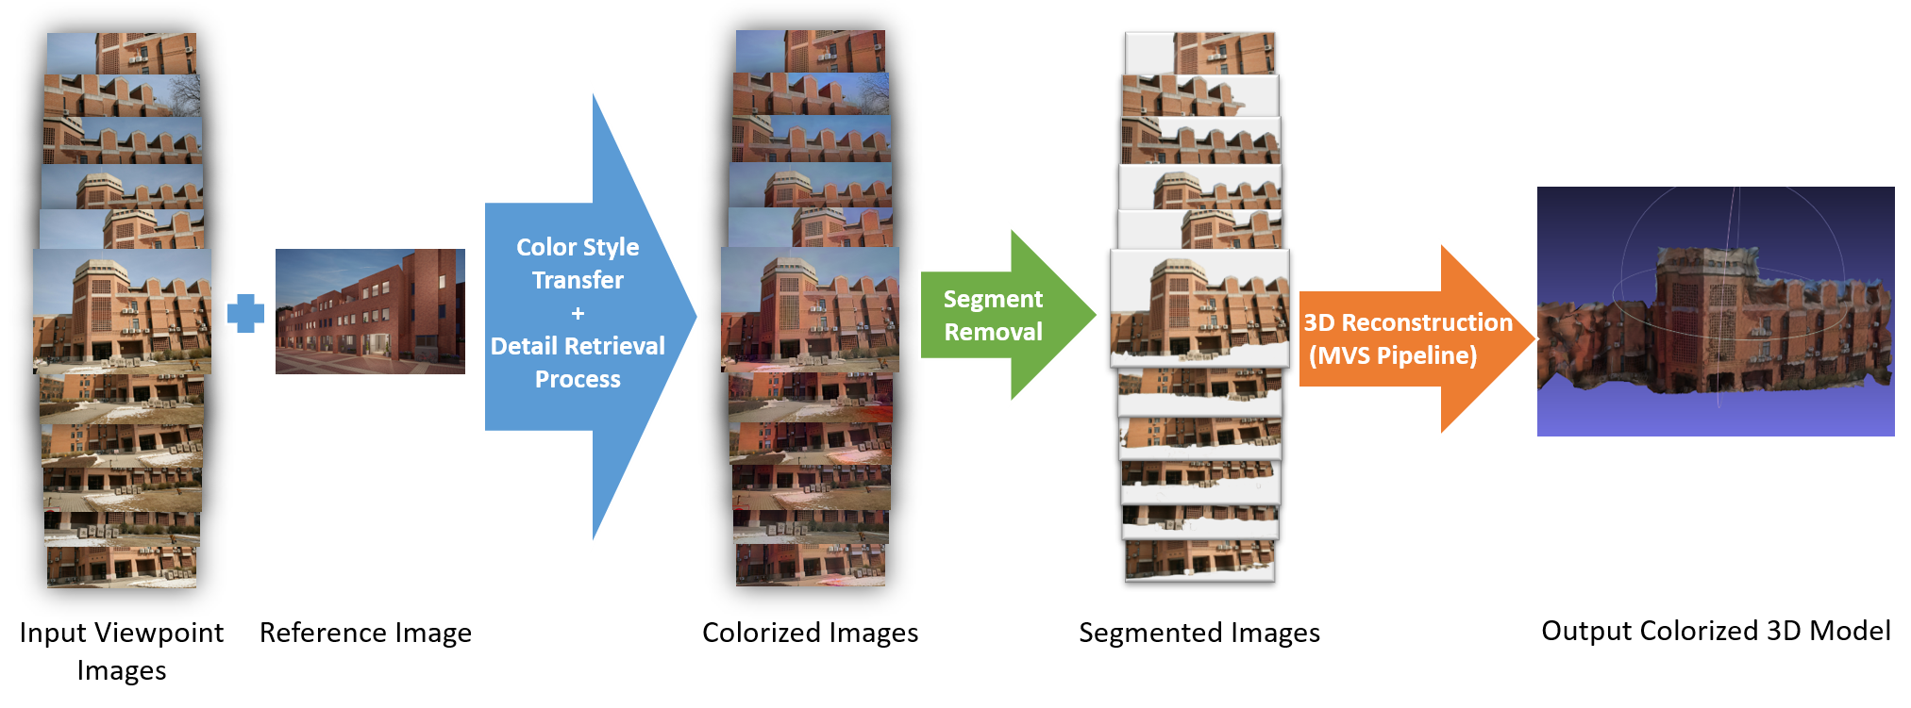
Main pipeline
The overall pipeline of 3D object reconstruction and style transfer from 2D image

Slide 6
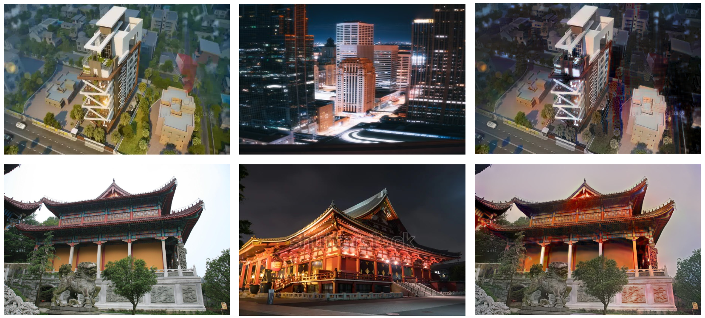
Image color style transfer
Apply the Deep Photo Style Transfer algorithm which proposed by Luan et al. [1]
Input Target Output
[1] F. Luan, S. Paris, E. Shechtman, and K. Bala. Deep photo style transfer. In Proceedings of the IEEE/CVF Conference on Computer Vision and Pattern Recognition, 2017.

Slide 7
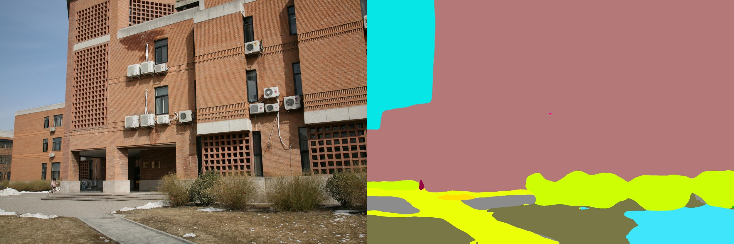
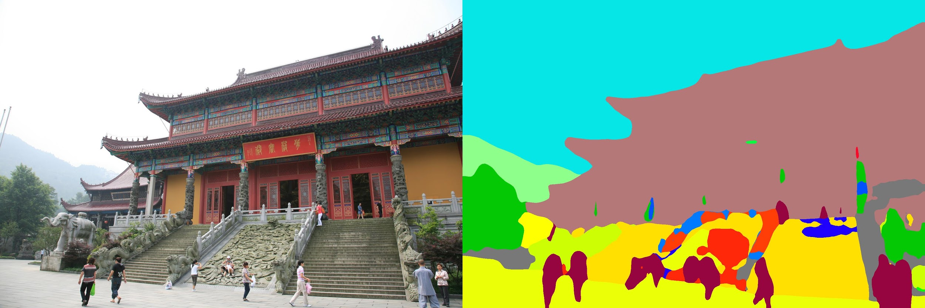
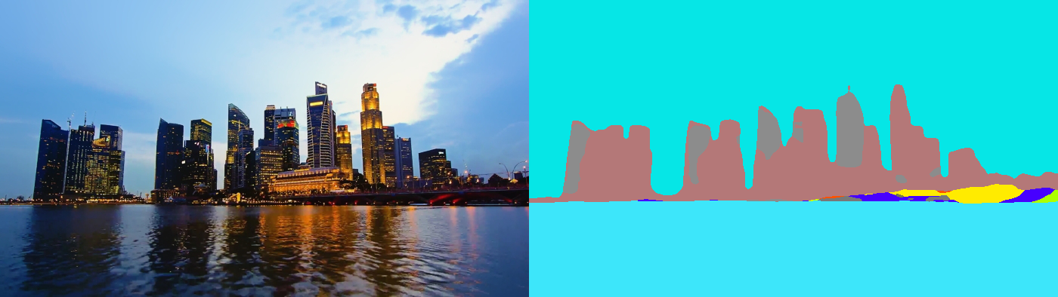

Image Segmentation
Apply the novel model ResNet-50-dilated [2] for Encoder and Pyramid Pooling Module with loss optimization from PSPNet [3] for Decoder.
[2] K. He, X. Zhang, S. Ren, and J. Sun. Deep residual learning for image recognition. CoRR, abs/1512.03385, 2015.
[3] H. Zhao, J. Shi, X. Qi, X. Wang, and J. Jia. Pyramid scene parsing network. In Proceedings of the IEEE/CVF Conference on Computer Vision and Pattern Recognition, 2017.

Slide 8
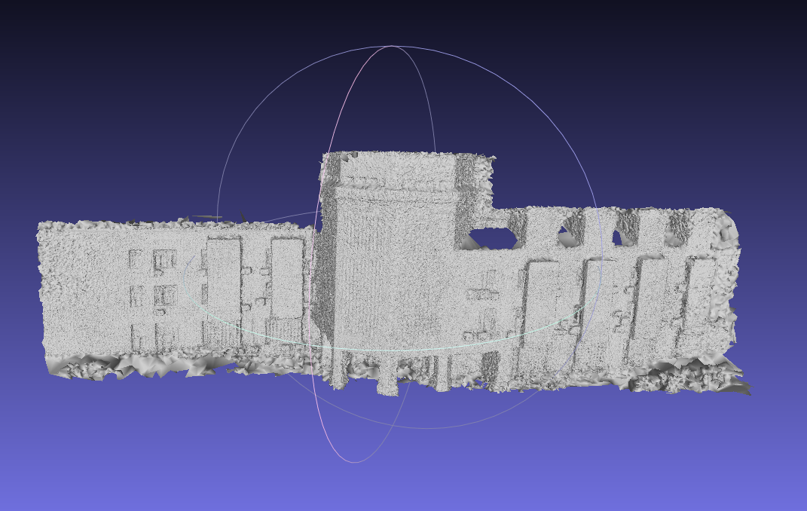
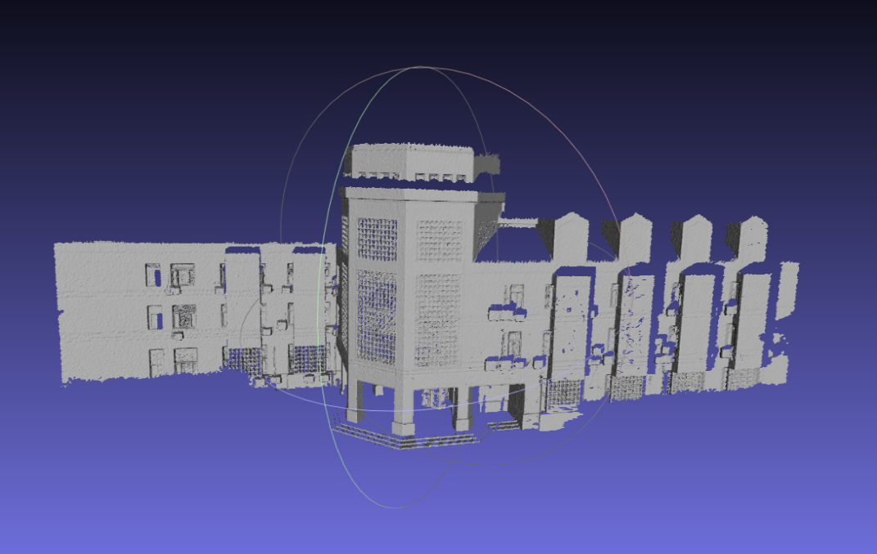
3D Reconstruction
Apply the photogrammetry based Multi-View Stereo (MVS) approach [4][5] for 3D reconstruction with the input is the segmented images and texturing using the colorized images.
Generated model Ground truth model
[4] J. L. Schonberger and J.-M. Frahm. Structure-from-motion revisited. In The IEEE Conference on Computer Vision and Pattern Recognition (CVPR), June 2016.
[5] M. Goesele, B. Curless, and S. M. Seitz. Multi-view stereo revisited. In 2006 IEEE Computer Society Conference on Computer Vision and Pattern Recognition (CVPR’06), 2006.

Slide 9
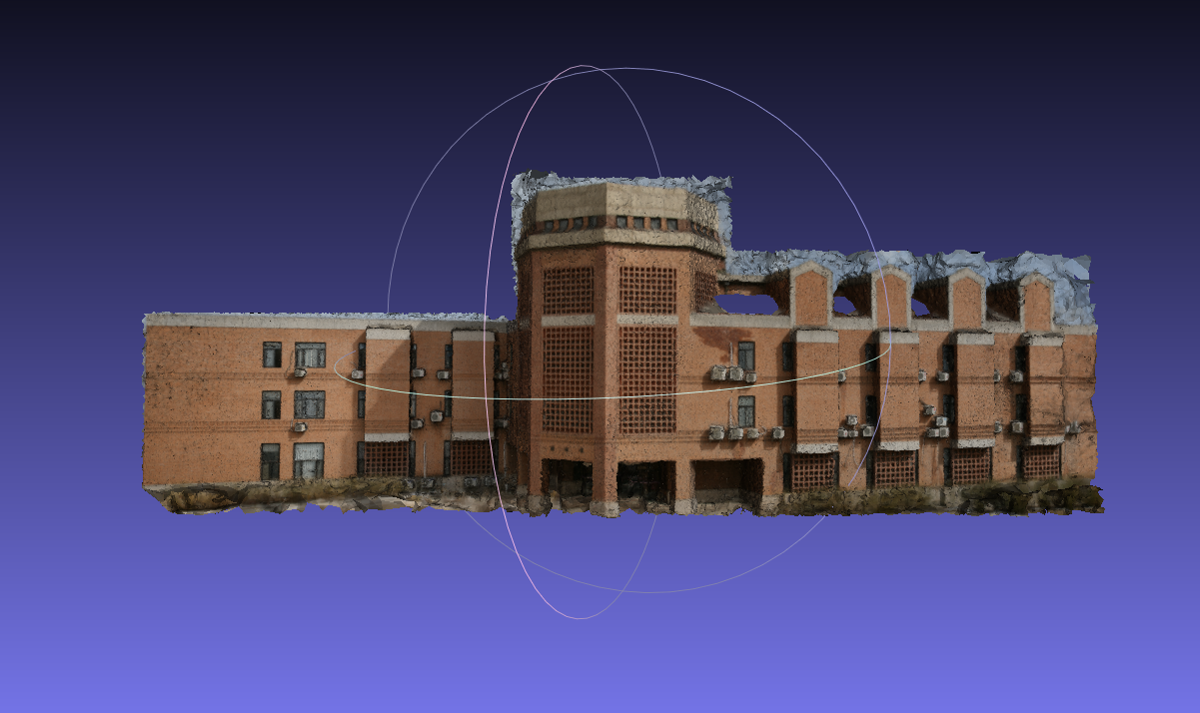
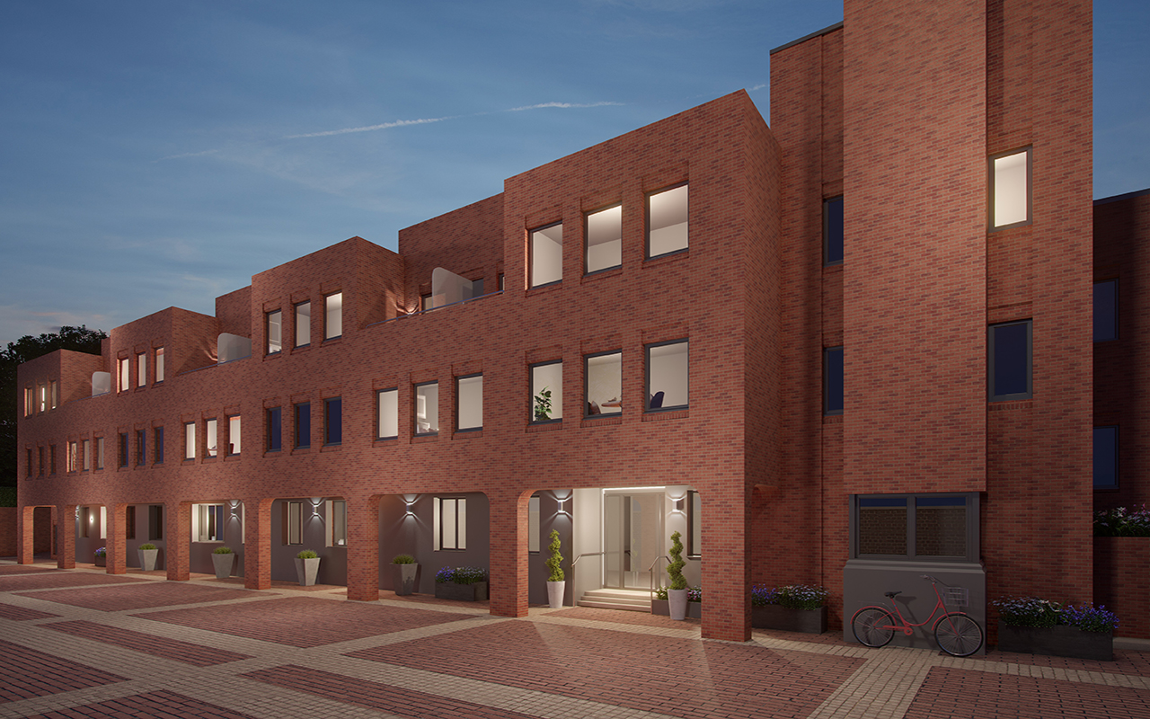
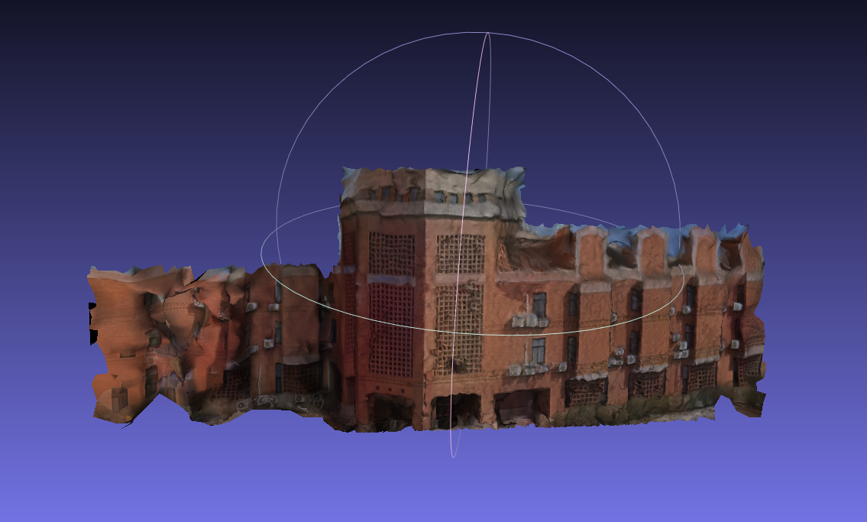
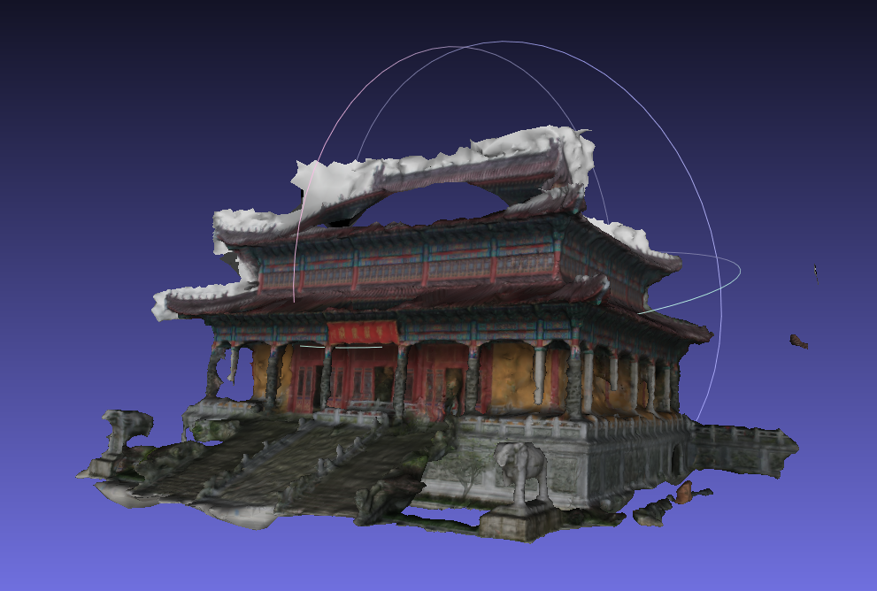
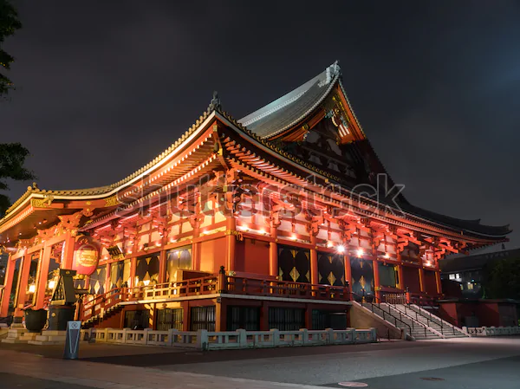
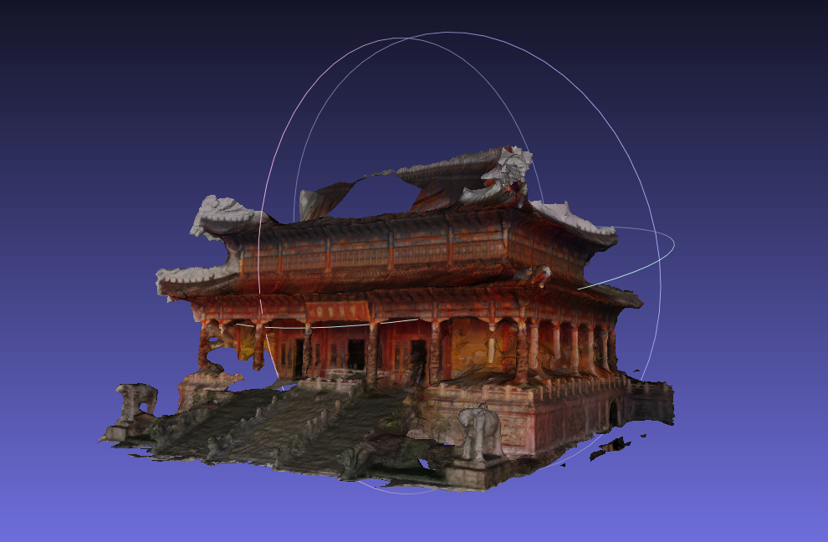
Experimental results
Input model Reference image Output model

Slide 10
Conclusion and future work
The colorization method can generate a plausible and usable 2D colorized image for later texturing use.
The semantic segmentation method can remove useless background and foreground.
The implemented flow in our methodology is capable of generating 3D models with desired color style transfer with a set of viewpoint images.
The details and the features of the reconstructed model might reduce compared to the original model due to the loss of features and resolution due to colorization.
In the future, this problem can be addressed by introducing a new texturing method to the original 3D model itself based on the reference images for the color transfer.

Slide 11
Thank you for your attention

